Slide 1
Specific Learning Disorders
Asiri Rodrigo

Slide 2
Specific Learning Disorders
Development is delayed in one specific area or areas, and in which basically all other areas of development are not affected
Dyslexia
Dysgraphia
Dyscalculia
In contrast to pervasive developmental disorder- delays in the development of multiple basic functions
Autism spectrum disorder
Rett syndrome

Slide 3
Dyslexia
Reading disorder - characterized by trouble with reading despite normal intelligence
Not due to hearing or vision problems or insufficient teaching
Generally a developmental disorders but may begin in adulthood as the result of a traumatic brain injury, stroke, or dementia (Alexia)
Affects 3-7%
Diagnosed more in males but M:F = 1:1

Slide 4
Dyslexia – Clinical features
Early childhood
Delayed onset of speech
Lack of phonological awareness
Easily distracted by background noise
School going children
Difficulties in spelling words
Difficulties in reading quickly
Difficulties in writing words
”Sounding out" words in the head
Pronouncing words when reading aloud
Understanding what one reads

Slide 5
Dyslexia – Clinical features
Adults
Summarizing stories
Memorization
Reading aloud
Learning foreign languages

Slide 6
Comorbidities
ADHD
12–24% of people with dyslexia have ADHD
35% of people with ADHD have dyslexia
Dysgraphia
Auditory processing disorder
Developmental coordination disorder

Slide 7
Causes
Neuroanatomy
Inferior frontal gyrus
Inferior parietal region
Middle and ventral temporal cortex
Genetic
DCDC2 and KIAA0319 on chromosome 6
DYX1C1 on chromosome 15
Environmental
Parental education
Teacher quality

Slide 8
Management of dyslexia
Compensation strategies
Therapy
Educational support
Management of anxiety and depression
Special help – dyslexia font

Slide 9
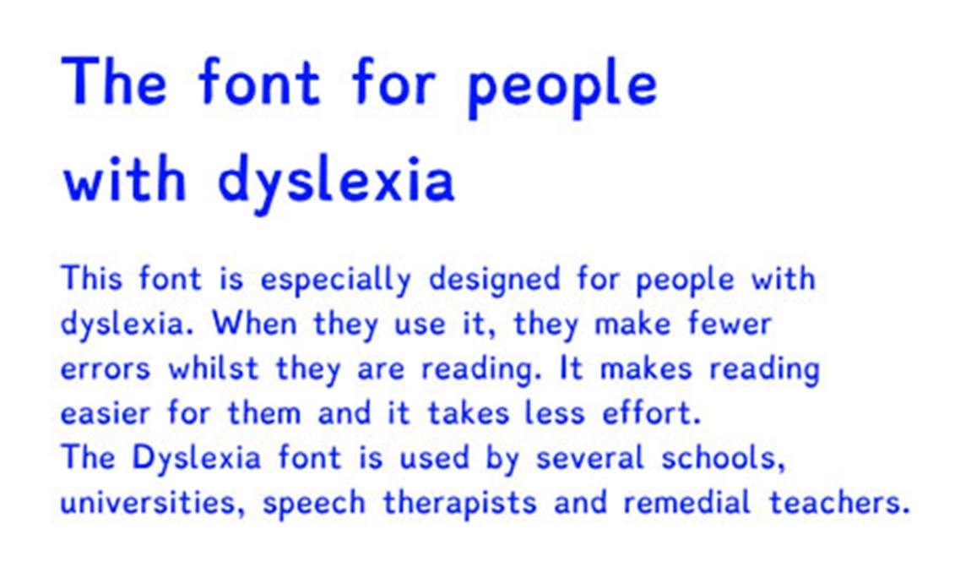

Slide 10
Dysgraphia
Deficiency in the ability to write - primarily handwriting
Impaired handwriting
Orthographic coding
Finger sequencing
Dyslexic dysgraphia- Copied work- good, spontaneous work- poor
Motor dysgraphia- Fine motor skills
Spatial dysgraphia – Writing –good, drawing – poor

Slide 11
Dysgraphia – clinical features
Cramping of fingers / odd wrist, arm, body, or paper orientations
May feel pain while writing
Excessive erasures
Mixed upper case and lower case letters
Inconsistent form and size of letters, or unfinished letters
Misuse of lines and margins

Slide 12
Dysgraphia – clinical features
Inefficient speed of copying
Frequent need of verbal cues
Poor legibility
Poor spatial planning on paper
Difficulty writing and thinking at the same time (creative writing)
Having a hard time translating ideas to writing

Slide 13
Dysgraphia – comorbidities
Speech impairment
ADHD
Developmental coordination disorder
Anxiety / depression

Slide 14
Dysgraphia – comorbidities
Occupational therapy
Fine motor skills training

Slide 15
Dyscalculia
Difficulty in learning or comprehending arithmetic,
Difficulty in understanding numbers
Learning how to manipulate numbers
Learning facts in mathematics
3 and 6% of the population
Can happen later on in the life (Acalculia)

Slide 16
Features of dyscalculia
Small children
Difficulty in Subitizing
difficulty with mental math
Trouble analyzing time and reading an analog clock
Struggle with motor sequencing that involves numbers
Often use their fingers when adding numbers
Adults
Careless errors with math
Directions while driving
Controlling their finances

Slide 17
Comorbidities of dyscalculia
ADHD
Spina bifida
Turner syndrome

Slide 18
Management of dyscalculia
Special education programmes
Software
Digital interventions

